Slide 1
Broadening formal models of individual and collective intentionality
Michael D. Ryall
University of Toronto
Brian Epstein
Tufts University

Slide 2
Background
Pandemic project
Interdisciplinary – social ontologist and game theorist
Interested in organizational cognition and action
Our naïve hypothesis:
Use some insights of social ontology, together with resources of game theory, make progress in refining and formalizing the agency of organizations… easy!
Not so fast

Slide 3
Some starting points and aims
Useful to think of organizations as agents, as possessing cognitive states
Some analogies to individual agents
Need more clarity on the functional roles of aspects of organizational cognition (and of intention in particular)
Much work on shared intentionality is built on intuitions about requirements for sharedness, rather than the roles shared intention plays in the “cognitive life” of an organization
At the same time, need to bridge organizational cognition with constitutive components
Individuals, structures, environment
Not necessarily a reductive project, yet need to model

Slide 4
Context: much work in the area
Intention in theory of action
Planning agency, claims of functional roles of intention for bounded agents
BDI and related models
I.e., formalizations of intention-involving cognitive systems
BDI agents in computer science, multi-agent systems
BDI logics, modal logics of action
Organizations
Collective intentionality, reductive and non-reductive treatments
Boundedness in organizational psychology
Intentional forgetting
Institutions as constraints and enablements
Game theory
Boundedness in game theory
Many forms: aspects of game known, uncertainty, agent-types, epistemic limitations
Unawareness
Pre-commitment
External to the agent; commitment device

Slide 5
Key issue
Informal models suggest but do not demonstrate the functional utility of these cognitive states
How precisely do they contribute to outcomes?
Why can’t we just use a more parsimonious model?
We agree that intention- or commitment-deficient bounded cognizers would have deficient outcomes
But not precise why and how
Agree with intuitive views of commitment in intention
Yet, addition of cognitive state seems ad hoc, or at least, imprecise
Especially with regard to features of commitment-making and commitment-abandonment
Opportunity to develop a more fundamental explanation

Slide 6
Other shortcomings and opportunities
Literatures are not integrated
Herzig et al. on the opportunity to develop formal theories of intention in action and game theory:
Just as the BDI model, decision theory and game theory are also about the behavior of agents given their goals and their information state. The relationship has however not been clarified up to now…
We believe that extending classical decision theory and game theory with the concept of intention might be relevant when trying to model resource-bounded agents who need to plan their future actions in advance since they have limited cognitive capacities and limited time for deliberation.
Herzig et al. 2017, “BDI logics for BDI architectures: Old Problems, New Perspectives”
BDI: very individual focused; strangely, not forward-looking
Implementations, not really explanatory
Not clear how or whether richer models of cognition should figure into game theory
Parsimonious models of agent cognition; simple version of belief-desire model
No obvious role for, e.g., Bratman-style intentions in these models
Game theory: no real role for organizational cognition
List and Pettit a slight exception, but not clear that it really gets at organizational cognition
The challenge isn’t just in treating organizational cognition
Need foundational work in richer treatment of individual cognition to connect theory of action

Slide 7
Project at intersection of game theory and theory of action
Two-step process:
Extend model of individual in game theory to take account of cognitive features that cannot be treated in current simple belief-desire model
As conservative as possible, to make use of mathematical resources and retain tractability
Develop model of organizational cognition with appropriate analogies to (and differences from) individual case
Grounded in individuals and nature, but taking organizational cognition appropriately seriously
Relation between models individual and organizational cognition
Need a compelling role for richer cognitive states at the individual level
If there isn’t such a role for game-theoretic treatment of individual cognition, not likely it’ll be necessary at the organizational level
In this discussion, we will focus on functions and models of intention in individual cognition
But we expect that similar points will be extensible to organizations

Slide 8
Central claim
Crucial features are:
The agent inhabiting a dynamically changing world
The agent deploying unawareness—either “triggered” or “intentional” unawareness in unfolding choice and action
The literature’s inquiry into planning is related, but not sufficient
A standard simple B-D model of cognition is sufficient to model plans
Develop more fundamental understanding of commitment, and thereby of key features of intention
Focus on individual case

Slide 9
Project at intersection of game theory and theory of action
Two-step process:
Extend model of individual in game theory to take account of cognitive features that cannot be treated in current simple belief-desire model
As conservative as possible, to make use of mathematical resources and retain tractability
Develop model of organizational cognition with appropriate analogies to (and differences from) individual case
Grounded in individuals and nature, but taking organizational cognition appropriately seriously
Relation between models individual and organizational cognition
Need a compelling role for richer cognitive states at the individual level
If there isn’t such a role for game-theoretic treatment of individual cognition, not likely it’ll be necessary at the organizational level
In this discussion, we will focus on functions and models of intention in individual cognition
But we expect that similar points will be extensible to organizations

Slide 10
Central claim
Crucial features are:
The agent inhabiting a dynamically changing world
The agent deploying unawareness—either “triggered” or “intentional” unawareness in unfolding choice and action
The literature’s inquiry into planning is related, but not sufficient
A standard simple B-D model of cognition is sufficient to model plans
[Something about plan reconsideration]

Slide 11
The best toy problem
The time is t = 0
Brian’s infant is sitting in the family room
Some distance in front of her are two toys, A and B
Things are going on around her: adults are chatting in the next room, the TV is on, the dog is barking outside
Infant desires the best toy
Best toy > second-best toy > no toy
Uncertain whether A or B is best
Tune-playing taken as signal of best
What happens

Slide 12
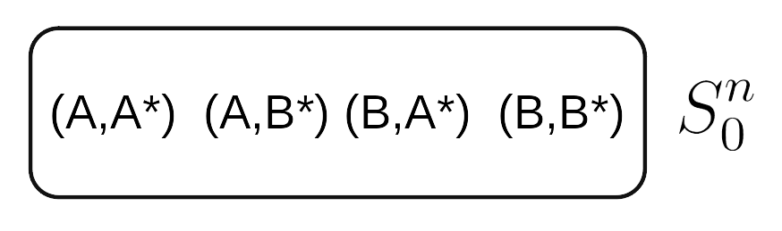
State spaces
“state” = a snapshot of all relevant features of the world
Nature = agent n
Time = period 0
(A,B*): A is ringing, B is best

Slide 13
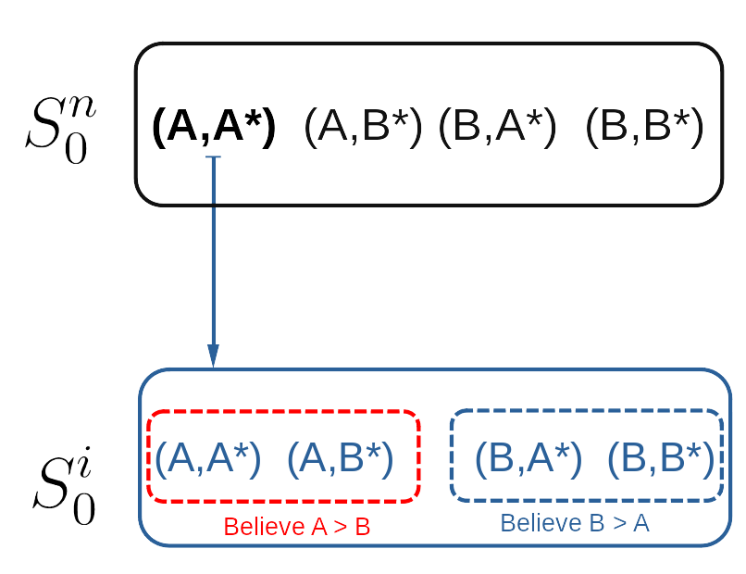
Mental states are also described
In (A,A*) ...
... this is individual 1’s grasp of the state space

Slide 14
Dynamic cognitional process
Time begins (t = 0)
Phase 1 - Focus: choose problem
New state determined by individual + Nature acts (t = 1)
Phase 2 - Intend: identify goal
New state (t = 2)
Phase 3 - Plan: elaborate plan to attain goal
New state (t = 3)
Phase 4 - Act: implement the plan
New state (t = 4)
No leapfrogging phases!

Slide 15
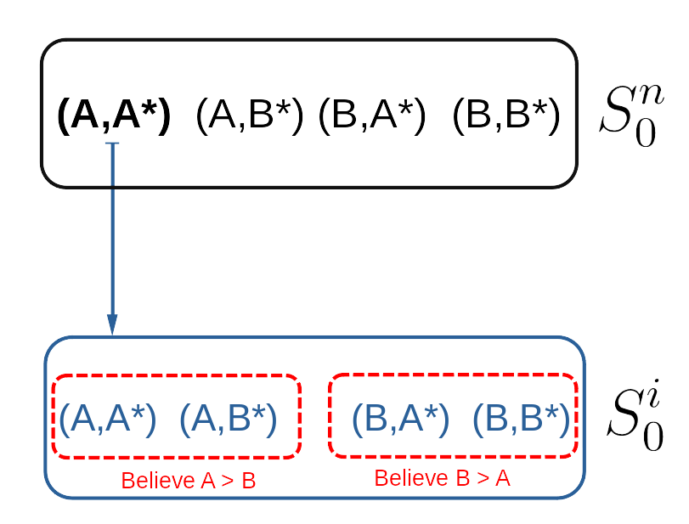

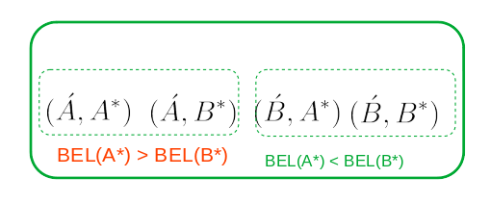

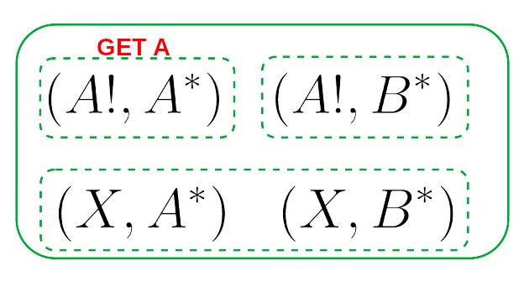


Individual envisions the future

Slide 16


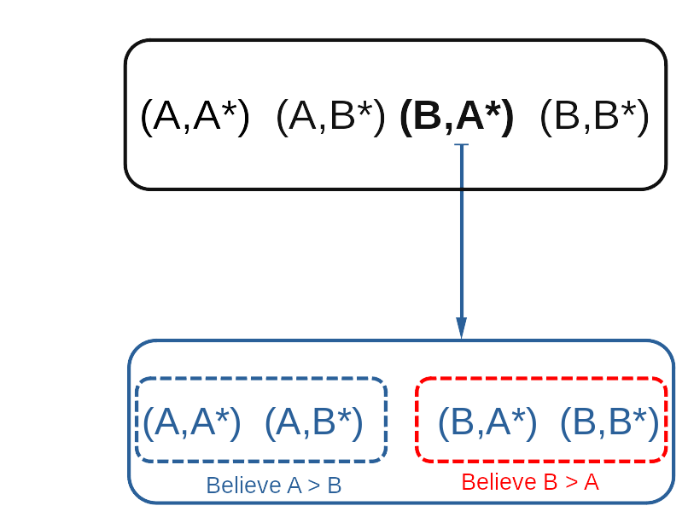
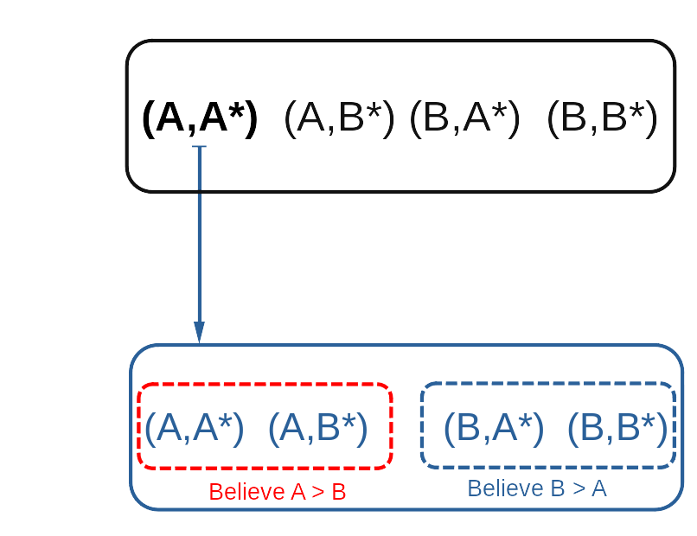


Rational agent information freeze
nature rings B
nature rings A
Choose to get best toy
Intend GET B
Intend GET A
How does a rational agent solve this problem?
⇨Commitment seems promising ... but how does it work?

Slide 17
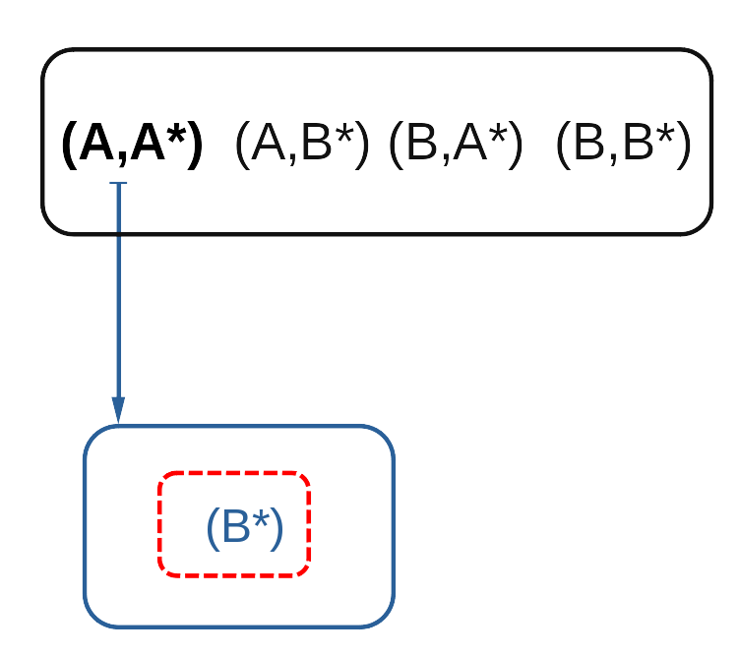
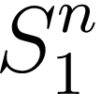
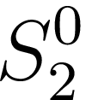




Commitment through “intentional unawareness”
nature rings B
nature rings A
Choose to get best toy
Intend GET B
Plan GET B
Unawareness structures: studied in game theory wrt unintentional unawareness
Map objective states to subjective states that reflect unawareness
Here, the intention determines what aspects of the world do not register with the decision maker
Note: if A is really best, Brian’s infant gets second-best ... which is better than nothing at all!

Slide 18
Takeaways, next steps
Intention is a form of internal commitment
What makes such commitments “credible”?
Intentional unawareness is one possible mechanism
Interesting questions
How and when are plans revised or disrupted?
Internal commitment in multi-agent settings?
Pivot to organizations
Requires work
Nevertheless, this model does seem scaleable

Slide 19
FIN

Slide 21
Challenge:
Richer formal models of cognition, like BDI, have no clear path to treating group cognition
In thinking about organizational cognition, build on this model? That would create an odd dissonance between individual and organizational agents
Game theoretic models have little impetus to enrich models of cognition
Yet it seems problematic to
Puzzle in connection with game theory
No internal pull from game theorists to enrich models of cognition
In fact, active resistance
Lots of success with parsimonious models of agents
Simple version of belief-desire psychology
No clear role for a richer cognitive system
In particular, one involving non-cognitivist states such as Bratman-style intentions
Possible implications:
No important functional role for intentions
Cognitivism
A missing element, perhaps obscured by the choice of phenomena to model
Wanted to pull stuff off the shelf and apply it to organizations
But having to build it more from scratch
Virtues of this work
Much clarification of alternative models, functions intention can perform
Resources that the parsimonious models have to accommodate these phenomena

Slide 22
Develop a model of individual intentionality that does something that can’t be done with just a BD model
As conservative as possible with regard to standard game theory
Game theory has gone on for 70 years without it, and thinking they don’t need it
Organizational behavior and powers deriving from the parts
Yield organizational level powers
Forward-looking agents acting interactively with one another
General methodology for arbitrarily sized groups of agents interacting in general settings
Stock market bubbles: global markets with lots of information
Firms and organizations; how organizational cultures figure
Common knowledge, attitudes about attitudes, belief hierarchies
Challenge to philosophy:
Social scientists seem to be doing fine on a belief-desire model
For formal approaches to the explanation of human behavior, game theory is the go-to thing
To argue that a cognitive story (e.g., involving intention) makes a difference, key to show that models neglecting it aren’t sufficient in a behaviorally significant way

Slide 23
Three areas of inquiry
Cognitive role of intention (and its accompanying commitment)
In particular, solving problems for the successful functioning of bounded agents (Bratman 1987)
Organizations as agents; organizational commitment
Modeling of forward-looking rational agents
Unexplored opportunity in applying game theory

Slide 24
Bounded rationality in game theory and action theory
Treating boundedness in game theory
Parsimonious ontology
Incorporate boundedness into rational action
Treating boundedness in action theory
Cognitive mechanisms for addressing bounded agents
Roles of intention (Bratman 1987)
Different approaches, virtues to each
Formal applications of action theory:
BDI logics, multi-agent systems
Limitations:
Limited explanatory power for treatment of bounds
Not clear how to apply to organizations
Game theory:
Ad hoc treatments of boundedness
Insufficient

Slide 25
Bratman on roles of intention in planning agency

Slide 26
Ways the literature has investigated this claim

Slide 27
Game theory as technology for modeling forward-looking agency

Slide 28
Group cognition
Modeling it, problems with making sense of groups as having cognitive states
Many people take a broadly functionalist approach, but lots of problems with this
Not clear whether this is right, and how close the functions need to conform to recognizable ones, and when they do fall short, what to do about that
Worse: not clear what the functions of cognitive states are, either in the group or the individual case

Slide 29
Action theory
One off; norms and regularities, some desiderata, but not enough to specify functions
Even bigger problem with multifunctionality
Formal models
BDI logics and architectures
Address functional role in a sense, but don’t really tell us what intentions and other cognitive states are for, i.e., how they benefit the system
Some hypotheses: bounded agents
One of the insights of Bratman’s work on intention is the forward-looking nature

Slide 30
Game theory
Forward-looking

